Slide 1
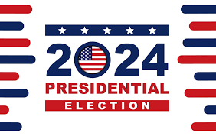
US ELECTION 2024
Name: Jannatul Ferdous Nisha
ID: 213100022

Slide 2
INDICTMENTS
Before and during the 2024 presidential election, Donald Trump faced multiple criminal indictments . As of December 2023, he had four criminal indictments totaling 86 felony counts. Trump and many Republicans made numerous false and misleading statements regarding Trump's criminal trials, including false claims that they are "rigged" or "election interference" orchestrated by Biden and the Democratic Party, of which there is no evidence.

Slide 3

14TH AMENDMENT REMOVAL ATTEMPTS
Several state courts and officials, including the Colorado Supreme Court , a state Circuit Court in Illinois , and the Secretary of State of Maine , ruled that Trump was ineligible to hold office under Section 3 of the Fourteenth Amendment to the United States Constitution for his role in the January 6 Capitol attack , and thus attempted to disqualify him from appearing on the ballot.These attempts were unsuccessful, and on March 4, 2024, the US Supreme Court unanimously ruled in Trump v. Anderson that states cannot determine eligibility for a national election under Section 3, and only Congress has the authority to disqualify candidates, or to pass legislation that allows courts to do so.

Slide 4

FOREIGN INTERFERENCE
Several foreign nations have interfered in the 2024 United States elections, with the most notable being China , Iran , and Russia . The efforts largely focused on propaganda and disinformation campaigns using inauthentic accounts on social media, stoking domestic divisions, and denigrating the United States and democracy more broadly.

Slide 5

DEMOCRACY
Polling before the election indicated profound dissatisfaction with the state of American democracy . Liberals tended to believe that conservatives were threatening the country with Christian nationalist autocratic tendencies following their attempts to overturn the 2020 election . According to an October 25 ABC/Ipsos poll, 49% of Americans saw Trump as a fascist , described as "a political extremist who seeks to act as a dictator, disregards individual rights and threatens or uses force against their opponents". Meanwhile, only 22% saw Harris as a fascist by this definition.

Slide 6
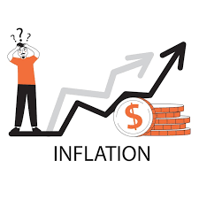
ECONOMIC ISSUES
Voters consistently cited the economy as their top issue in the 2024 election. Following the COVID-19 pandemic , a global surge in inflation ensued that raised prices on many goods, although the US inflation rate had declined significantly during 2023 and 2024. The New York Times reported that both candidates "embraced a vision of a powerful federal government, using its muscle to intervene in markets in pursuit of a stronger and more prosperous economy."

Slide 7

IMMIGRATION
Border security and immigration were among the top issues concerning potential voters in the election. Polling showed that most Americans wanted to reduce immigration, and that a substantial minority of White Republicans were concerned about White demographic decline . In 2023 and early 2024, a surge of migrants entering across the border with Mexico occurred. By June 2024, illegal crossings reached a three-year low following four consecutive monthly drops, which senior officials attributed to increased enforcement between the United States and Mexico, the weather, and Biden's executive order increasing asylum restrictions.

Slide 8

FOREIGN RELATIONS
While many cities and universities experienced anti-Israeli protests calling on the US to end its support for the Israeli government and other Israeli institutions, which included calls for Americans to not support the 2024 election efforts of President Biden or Vice President Harris due to their administrations continued support for Israel, Domestic American Pro-Israel groups had meanwhile spent large sums of money to support pro-Israel candidates against candidates critical of the Israeli government . According to a campaign finance analysis by Politico , AIPAC was the "biggest source of Republican money flowing into competitive Democratic primaries this year."

Slide 9
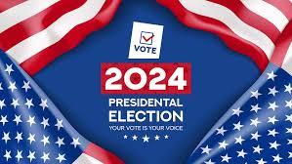
PRESIDENTIAL ELECTION
The 2024 United States presidential election was the 60th quadrennial US presidential election. This was the first presidential election under the electoral vote distribution determined by the 2020 census . Presidential electors who would elect the President and Vice President of the United States were chosen; a simple majority (270) of the 538 electoral votes is required to win the election.

Slide 10
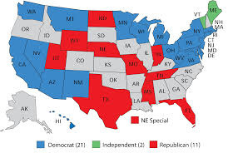
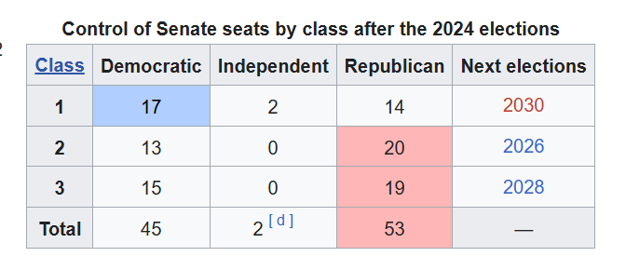
SENATE ELECTIONS
All 33 seats in Senate Class 1 and one seat in Senate Class 2 were up for election; two additional special elections took place to fill vacancies that arose during the 118th Congress . Democrats controlled the majority in the closely divided Senate following the 2022 US Senate elections , but they had to defend 23 seats in 2024. Three Democratic-held seats up for election were in the heavily Republican-leaning states of Montana , Ohio , and West Virginia , all of which were won comfortably by Trump in both 2016 and 2020

Slide 11

HOUSE OF REPRESENTATIVES ELECTIONS
All 435 seats voting in the United States House of Representatives were up for election. Additionally, elections were held to select the non-voting members who represent the District of Columbia and all five permanently-inhabited US territories in the House of Representatives. Republicans held a narrow majority in the House of Representatives following the 2022 US House elections .

Slide 12
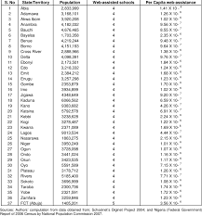
TABLE OF STATE, TERRITORIAL, AND FEDERAL RESULTS
This table shows the partisan results of presidential, congressional, gubernatorial, and state legislative races held in each state and territory in 2024. Note that not all states and territories hold gubernatorial, state legislative, and Senate elections in 2024. The five territories and Washington , DC , do not elect members of the Senate, and the territories do not take part in presidential elections; instead, they each elect one non-voting member of the House. Nebraska's unicameral legislature and the governorship and legislature of American Samoa are elected on a non-partisan basis, and political party affiliation is not listed.

Slide 13
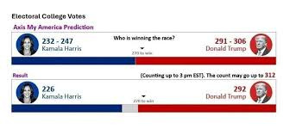
THE FINAL RESULT USA ELECTION

Slide 14


